Slide 1
Week 03

Slide 2
Updates
Lab 02 Live
Due Monday, 9/13 at 11:59 PM
Lab 01 Late
Can resubmit for late credit
Due no later than Wednesday at 11:59 PM (10% off / day)
Must be done to continue successfully
Quiz 9/9
2 attempts
Open from 8:00 AM to 11:59 PM

Slide 3
AWS Quick Check
Can ssh (remotely access) the system built in AWS
This is really a virtual machine. Welcome to the CLOUD
Contact the Tas or I if you need help
Resource creation check:
We have an AWS gift card. Let’s check we aren’t overspending
https://www.awseducate.com/student/s/
Services -> Management & Governance -> CloudFormation
Should only see one thing. If more things, contact the Tas or I
Or you will spend too much money.

Slide 4
The Course Commandments
Thou shalt do labs in bits through the week
We have two hours of lab sessions. It is expected labs take about 2 hours.
Lab are broken into parts to help you chunk up tasks
Thou can request appointments outside of office hours if needed
Thou shalt put course name in email
Or I will ask who you are before I can help you
Thou shalt CC TA(s)
Thou shalt use Discord for best response time

Slide 5
The Shell Commandments
Thou shalt always read thine output after running a command
No output = something worked.
Was it what you wanted?
When asking for help, thou shalt give the command AND the output
Additionally, whatever steps you remember that may have been odd

Slide 6
Terminology
Windows = Windows
WSL2 = WSL2
WSL2 != Windows
AWS instance = thing you SSH into
AWS instance != WSL2
Local is whatever system you typed SSH into

Slide 7
Working with Directories

Slide 8
Directories / Folders
Keeps the association of name(s) and location of content(s)
Names of files and corresponding I-nodes
Every directory has a parent directory it belongs to
The top level directory is parent of itself
In a directory, if you run "ls –lah", you'll see two listings with dots
"." is a reference to itself
".." is a reference to it's parent

Slide 9
Creating Directories & Files
Commands for folders:
mkdir, rmdir, ls
Commands for files:
cat, vim / nano, touch, rm, head / tail - less / more
Commands to move / change structure
mv, cp
Notes:
This assumes you know how in Windows, but maybe not in a command line

Slide 10
* Vs .
* - a wildcard pattern matcher
/etc/*-release will match anything that ends in “-release” in /etc/
. – think “this directory right here”
“git add .”– add anything in this directory
.. – think “the directory before”

Slide 11
Importance of Names & Extensions
Some programs (especially Windows) rely on extension to assign default programs that open the file type
Enable file type viewing in Windows
In Linux, extensions are important for consistency & universal understanding
Naming conventions
Avoid spaces, strange special characters, etc.
My School Folder vs “My School Folder”

Slide 12
Back to Users & Groups

Slide 13
Previously
Linux file / folder permissions
r, w, x
u, g, o
$ chmod

Slide 14
QUIZ TODAY!
OPEN UNTIL 11:59 PM

Slide 15
Users & Groups
$ adduser new_username
Creates user, has you give them a password, creates their home directory
$ chown username file_or_folder_name
Change the owner of a file or folder
$ addgroup new_groupname
Create a new group
Checkout /etc/group - this is where you add groupies to groups
$ chgrp groupname file_or_folder_name
Change the group of a file or folder
Notes:
https://linuxize.com/post/how-to-add-user-to-group-in-linux/

Slide 16
Adding a user
What are we editing when we add a user? What permissions do we need?
# adduser username
The “good” one
Asks for all info, creates a home dir
# useradd username
The “bad” one
All user info is an option you need to remember and add to the creation command
$ chown newowner fileorfolder
Change ownership

Slide 17
Who are you? Who who
$ whoami
Returns the username you are currently using
$ id
Returns all the groups you are a member of

Slide 18
Passwords and a nod to PAM
PAM = Pluggable Authenticaton Module
Linux systems use PAM by default, you can add other types of authentication
LDAP, Active Directory, etc.
PAM looks in some spots:
/etc/passwd
If the account is locally made, there will be a listing here
Can set if the given user can log in. Why does that matter?
/etc/shadow
Passwords are not stored as plain text anymore
Notes:
https://book.hacktricks.xyz/linux-unix/privilege-escalation/pam-pluggable-authentication-modules

Slide 19
Messing with Groups
# addgroup groupname
/etc/groups
This is also where you go to add users to the sudo group
$ chgrp newgroupname fileorfolder

Slide 20
Messing with sudo
$ sudo su
Switches to root user
The ubuntu account has passwordless sudo
/etc/sudoers
Where sudo configs go. Based on username or group I can define what commands they can run as sudo
https://www.digitalocean.com/community/tutorials/how-to-edit-the-sudoers-file
$ sudo su username
$ su username - prompts for the password of the username
Pay attention to where you are - $ pwd

Slide 21
Copy & move
$ cp - makes a full copy of a file / folder
$ mv - moves file or folder
Also used to RENAME a file or folder

Slide 22
Resources
https://its.unc.edu/research-computing/techdocs/how-to-use-unix-and-linux-file-permissions/
https://www.linux.com/training-tutorials/understanding-linux-file-permissions/
https://linuxcommand.org/lc3_lts0090.php
https://linuxize.com/post/understanding-linux-file-permissions/

Slide 23
Windows File Permissions

Slide 24
Access Control Lists
Made up of two elements
DACL - Discretionary Access Control List
identifies the users and groups that are allowed or denied access
SACL - System Access Control List
controls how access is audited
https://book.hacktricks.xyz/windows/windows-local-privilege-escalation/acls-dacls-sacls-aces

Slide 25
Purpose of SACL - traces users over time who have accessed or tried to access a file
It’s a log.

Slide 26
Permissions: Windows NTFS
Find folder / file in Windows Explorer, right click, go to Properties, go to Security tab
Read & execute:
Allows users to view and run executable files, including scripts.
Read:
Allows users to view the folder and subfolder contents.
Write:
Allows users to add files and subfolders, allows you to write to a file.
Notes:
https://www.varonis.com/blog/ntfs-permissions-vs-share/

Slide 27
Permissions: Windows NTFS
Full control:
Allows users to read, write, change, and delete files and subfolders. In addition, users can change permissions settings for all files and subdirectories.
Modify:
Allows users to read and write of files and subfolders; also allows deletion of the folder.
List folder contents:
Permits viewing and listing of files and subfolders as well as executing of files; inherited by folders only.

Slide 28
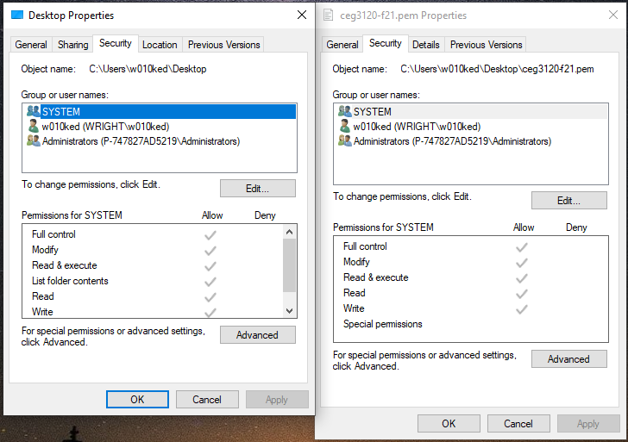

Slide 29
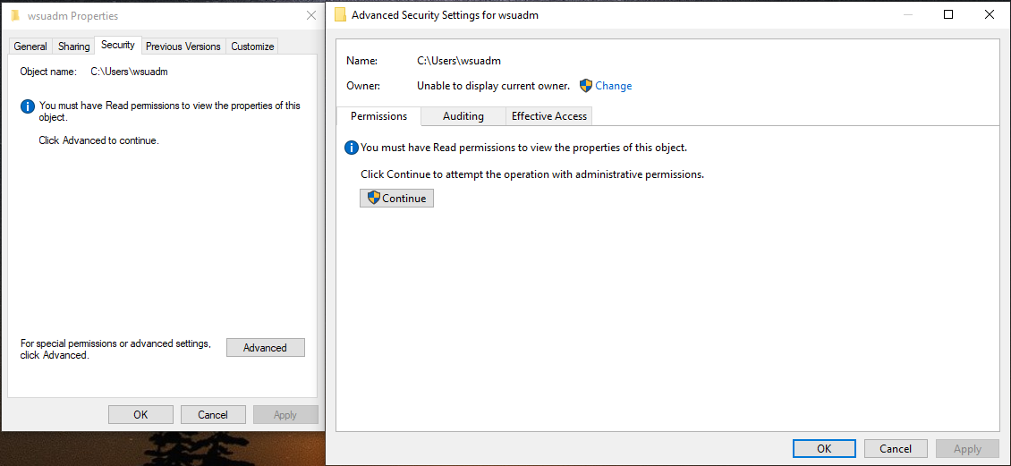
What about files my user shouldn’t be in?

Slide 30
Managing Users & Groups with Powershell
> get-localuser
> get-localgroup
> Get-LocalGroupMember Administrators
https://techcommunity.microsoft.com/t5/itops-talk-blog/how-to-manage-local-users-and-groups-using-powershell/ba-p/733544

Slide 31
Powershell: Create New User & Add to Group
> $Password = Read-Host -AsSecureString
> New-LocalUser -Name Optimus -Description “Second Admin Account” -Password $Password
> Add-LocalGroupMember -Group “Administrators” -Member Optimus
Note: A lot of Windows management has to do with domains - org wide user and group structuring and access control

Slide 32
Windows: Two Shells to Note
Powershell
cmd.exe
Windows keep saying they will deprecate this for Powershell
dir = ls
Create a file:
notepad file_name
Opens file_name in Notepad
echo “My text for my file” > file_name
Redirects output into file_name
> bash -c “vim filename”
(If WSL2 is installed) - opens command line text editor vim
Notes:
https://petri.com/quickly_create_txt_file_from_cmd

Slide 33
Permissions: Windows command line
Access Control List (ACL) in Windows sets user permissions
“icacls"
Displays or modifies access control lists of files
https://docs.microsoft.com/en-us/windows-server/administration/windows-commands/icacls
Notes:
https://www.cyberciti.biz/tips/windows-change-access-permissions-from-the-command-line.html

Slide 34
Admin Permissions in Windows
Program will request elevated privileges
Some may pause (an install, for example) and ask you to restart install as admin
Run as Administrator
Use elevated privileges, if you have them.

Slide 35
Could you ACLS in Linux?
Yes.
https://linuxconfig.org/how-to-manage-acls-on-linux
Note ACLS and ugo do not get along
Windows vs WSL2

Slide 36
Who is in charge?
Powershell
Running commands with bash -c
Is it a mini shell of WSL2

Slide 37
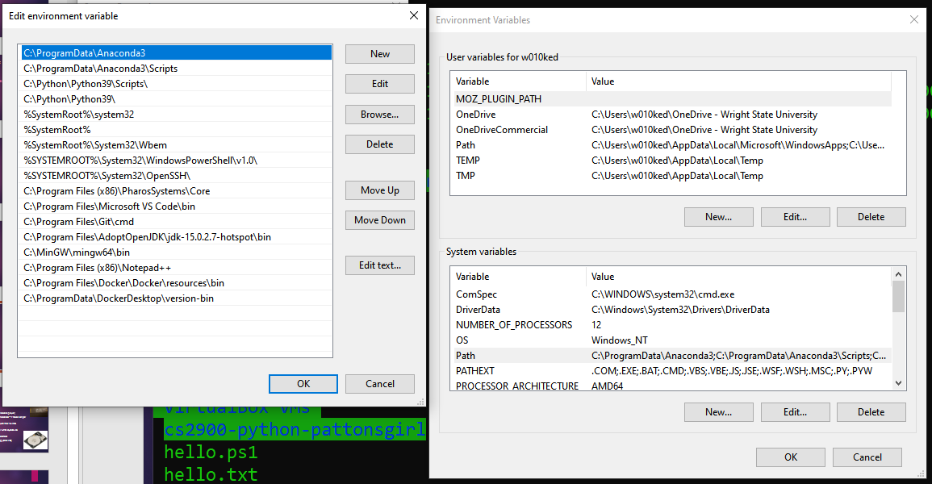
PATH

Slide 38


Slide 39
Review of git commands
$ git add filename
Add a new file for tracking by git
$ git commit -a
Leave a “post-it” of changes that have occurred since last time
$ git push
Push commits (record of changes) to remote - in our case, GitHub
Only work if in a git directory (a .git folder needs to exist in the current directory or its parent(s))

